Slide 1
A3435 – Major Project Domain: Signal & Image Processing
VARDHAMAN COLLEGE OF ENGINEERING, HYDERABAD
Autonomous institute, affiliated to JNTUH
Team No. – IV
Practical Implementation of Image Processing based Vehicle Speed Monitoring System
17881A04K2 – J.Hrudaya
17881A04M4 – Rithika Rao.D
17881A04P8 – B.Vinoothna
By:
Under the guidance of
Dr.D.KRISHNA
Associate Professor, Dept. of ECE

Slide 2
Practical Implementation of Image Processing based Vehicle Speed Monitoring System
Outline:
Objectives
Motivation
Introduction
Literature Survey
Proposed Design
Comparative Analysis
Expected Deliverables
References

Slide 3
Practical Implementation of Image Processing based Vehicle Speed Monitoring System
Objectives:
The idea behind our project is to detect the speed of vehicles which is an important aspect for observing speed limitation law and traffic condition.
It is also an effective method to control over speed vehicles and to be found guilty in leading to traffic accidents.

Slide 4
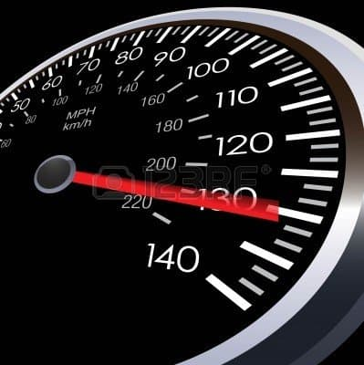
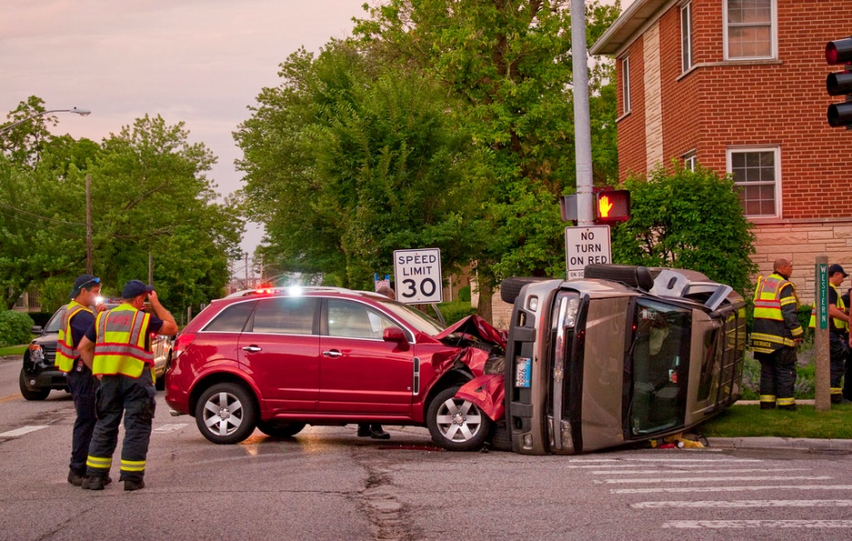
Practical Implementation of Image Processing based Vehicle Speed Monitoring System
Motivation:
Over speed
Over Speed Vehicles leading to accidents

Slide 5
Practical Implementation of Image Processing based Vehicle Speed Monitoring System
Introduction:
Rash driving is the cause of many road accidents all over the world. The traffic population has increased considerably as there is no effective means to control or monitor the speed of vehicles running on roads.
This System provides an effective of monitoring the speed of vehicle to avoid such accidents.
The vehicle’s speed information is based on the video recorded using a camera.
Theoretically we use methods such as Gaussian mixture models, DBSCAN, Kalman filter and Optical flow. Practical implementation consists of description of modes of communication of individual segments.
The final speed of a particular vehicle is concluded by different natures of driving and it’s position at various instances of time of the recording.

Slide 6
Practical Implementation of Image Processing based Vehicle Speed Monitoring System
Literature Survey:
Paper Title
Vehicle Speed Detection from Camera Stream Using Image Processing Methods
Authors
Jozef Gerát, Dominik Sopiak, Miloš Oravec, Jarmila Pavloviˇcová
Journal
IEEE ,59th International Symposium ELMAR-2017
Proposed work
The paper deals with the topic of detection of vehicle speed based on information from video record. It comprises the tests of obtained video records using different vehicles, different natures of driving and the vehicle position at the time of recording.
Techniques involved
Gaussian mixture models, DBSCAN, Kalman ﬁlter, Optical ﬂow.
Drawbacks
It can’t detect speed from vertically movement in cluster of vehicles (by using adaptive weights of pixels).

Slide 7
Practical Implementation of Image Processing based Vehicle Speed Monitoring System
Literature Survey:
Paper Title
Speed Detection using Image Processing
Authors
Pranith Kumar Thadagoppula, Vikas Upadhyaya
Journal
IEEE 2016 International Conference on Computer, Control, Informatics and its Applications
Proposed work
Use mere CCTV cameras on highways to detect the speed of vehicles. The prototype developed is designed using MATLAB software and can process on core2duo processor with 2Ghz.
Techniques involved
Background subtraction, Adaptive Background subtraction , Object segmentation, Object labeling, bounding box and Calibration factor-real-world distance to pixel ratio
Drawbacks
It can’t work under foggy situations.

Slide 8
Practical Implementation of Image Processing based Vehicle Speed Monitoring System
Literature Survey:
Paper Title
Vehicle speed detection using video streams using image processing
Authors
Mohammed Reduanal Haque, Md.Golam Moazzam, Saiful Islam, Rony Das
Journal
IEEE 2016 International workshop on Computational Intelligence(IWCI)
In this paper, they have developed an image-based vehicle speed detection where a physics based velocity theory is used to calculate speed of moving vehicle from the recording video.
Proposed work
Techniques involved
Five major techniques used ,image acquisition and enhancement, segmentation, centroid, calculation, shadow removal and speed calculation .
For vehicle speed detection: temporal differencing algorithm.
Noise removal: trial and error method
Drawbacks
Error rate is quiet more when compared to traditional methods like RADAR etc.

Slide 9
Practical Implementation of Image Processing based Vehicle Speed Monitoring System
Literature Survey:
Paper Title
Image processing based vehicle detection and tracking method
Authors
Prem Kumar Bhaskar, Suet-Peng Yong
Journal
IEEE, 2014 International Conference on Computer and Information Sciences
Proposed work
Paper aims to develop an automatic vehicle counting system, which can process videos recorded from stationery cameras over the road for traffic data retrieval.
Techniques involved
Gaussian Mixture Model (GMM)-used to separate the objects in motion for the count. Blob Detection technique-to trace the movements of the objects within the frame. Blob analysis -identifies potential objects and puts a box around them.
Drawbacks
Automatic vehicle counting system counts somewhat less than the actual number of vehicle due to congestion heavy traffic flow situation in one scenario.

Slide 10
Practical Implementation of Image Processing based Vehicle Speed Monitoring System
Literature Survey:
Paper Title
A Review on Video Based Vehicle Detection, Recognition and Tracking
Authors
Shobha B S, Deepu R
Journal
3rd IEEE International Conference on Computational Systems and Information Technology for Sustainable Solutions 2018
Proposed work
They have been proposed for detection which includes appearance based models and motion based models .Vehicle recognition based on various attributes such as color, license plate, logos are discussed. Region based and feature based tracking along with various tracking algorithms are surveyed. Multi-view methods for vehicle detection are also discussed.
Techniques involved
It describes Single camera approach, Multi camera approach and summarizes the findings.

Slide 11
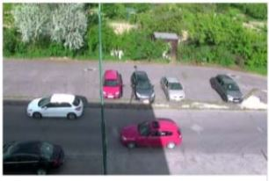
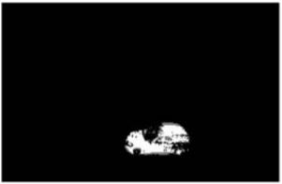
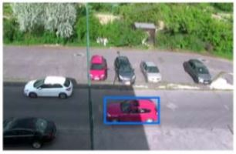
Practical Implementation of Image Processing based Vehicle Speed Monitoring System
Proposed Method (Design):
Foreground Detection
Find Bounding Boxes
DBSCAN
Detect motion from Kalman Filter
Estimate average velocity
Visualize

Slide 12
Practical Implementation of Image Processing based Vehicle Speed Monitoring System
DATABASE: The input is taken in the form of a video which is captured using a camera whose screen size will be 1280x1024. For the data base, 4 videos of similar resolution are taken.
FOREGROUND DETECTION: It is based on Adaptive Background Subtraction which is called as Gaussian Mixture model where the background of the image is subtracted to detect the required object by comparing the pixel value with the threshold value and classified into foreground and background image.
DBSCAN(Density based Spatial clustering of Application with Noise): The set of foreground points are specified using clusters which are given by Gaussian mixture model which are closely packed together to form an outline which is marked by bounding boxes.
BOUNDING BOXES: They are circumcised rectangles used for easy representation of the clusters.
DETECTION OF MOTION USING KALMAN FILTER: It uses series of measurements over a period of time which includes statistical noise, inaccuracies and estimates the value of unknown variable. It’s working simply is based on predicting the current state variable along with uncertainties and calculating the next state variables and then updating the previous state variables.
ESTIMATION OF AVERAGE VELOCITY: (distance/no. of frames)*k
let the distance be assumed as 10m
no. of frames= the difference between final frame and initial frame
k=constant value
for the first vehicle, the speed is assumed and then the constant value k is calculated. With respect to the calculated
k value, the speed of remaining vehicles is calculated using the formula.

Slide 13
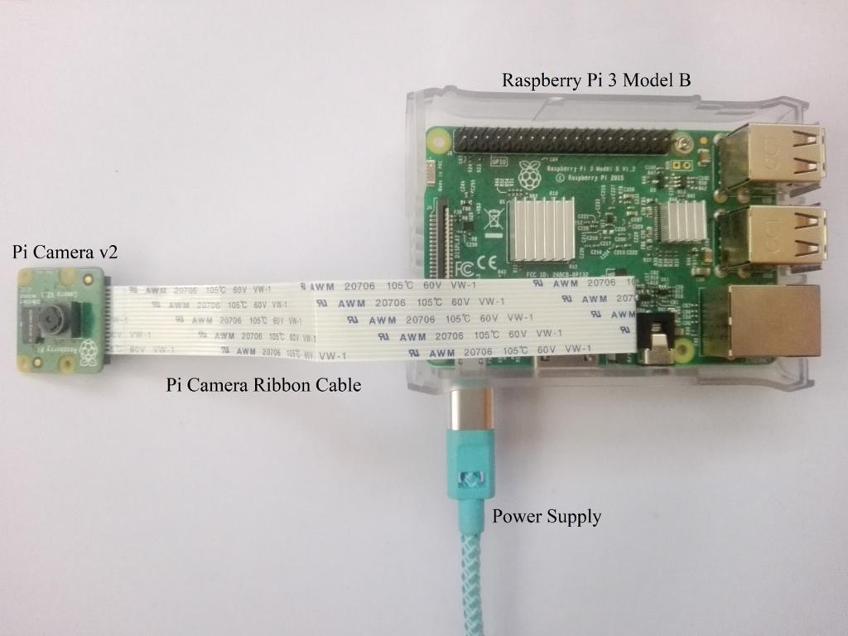
Practical Implementation of Image Processing based Vehicle Speed Monitoring System
7. VISUALIZE: It is simply testing where series of videos are taken into consideration and techniques mentioned are performed and concluded whether the respective vehicles exceeded the speed or not.
HARDWARE IMPLEMENTATION
The video will be recorded by the camera which is connected to the Raspberry Pi model. The algorithm corresponding to the respective steps to be performed will be dumped into raspberry pi model and the power supply will be given. The result can be viewed using a display and can be concluded.

Slide 14
Practical Implementation of Image Processing based Vehicle Speed Monitoring System
Comparative Analysis (Existed vs Proposed):
Existed
Proposed
Conventionally Radar technology is the current way used for speed detection. The main drawback of this method is the usage of radar guns.
Speed of only one object can be found at an instance.
While in use, if there are any devices that generate radio waves in the near vicinity, the results are influenced.
Extremely expensive.
Radar gun must be pointed towards the direct path of the incoming traffic.
The vehicle’s speed information is based on the video recorded using a camera. Theoretically we use methods such as Gaussian mixture models, DBSCAN, Kalman filter and Optical flow and make a practical Implementation using Raspberry pi through camera stream and get display on it.
The final speed of a particular vehicle is concluded by different natures of driving and its position at various instances of time of the recording.

Slide 15
Practical Implementation of Image Processing based Vehicle Speed Monitoring System
Expected Deliverables:
The proposed method is used to estimate speed of vehicles on the highways and city areas and can be effectively implemented to control the over speed vehicles and to be found guilty in leading to traffic accidents.
The video of a moving vehicle will be captured using camera which is used as a database. The vehicle’s speed information is based on the video recorded using a camera.
The final speed of a particular vehicle is concluded by different natures of driving and it’s position at various instances of time of the recording.
We will improve optical low method with Kalman filter tracking to solve the problem with overlays with static foreground objects and also improve speed detection.
Also foreground detection by Gaussian mixture model will be combined with DBSCAN clustering to create more precise object representation.
Publications of project in Scopus indexed conference/journal.

Slide 16
Practical Implementation of Image Processing based Vehicle Speed Monitoring System
References:
[1] J. Gerát, D. Sopiak, M. Oravec and J. Pavlovicová, "Vehicle speed detection from camera stream using image processing methods," 2017 International Symposium ELMAR, Zadar, 2017, pp. 201-204, doi: 10.23919/ELMAR.2017.8124468.
[2] P. K. Thadagoppula and V. Upadhyaya, "Speed detection using image processing," 2016 International Conference on Computer, Control, Informatics and its Applications (IC3INA), Tangerang, 2016, pp. 11-16, doi: 10.1109/IC3INA.2016.7863015.
[3] M. R. Haque, M. G. Moazzam, S. Islam, R. Das and M. S. Uddin, "Vehicle speed determination from video streams using image processing," 2016 International Workshop on Computational Intelligence (IWCI), Dhaka, 2016, pp. 252-255, doi: 10.1109/IWCI.2016.7860375.
[4] P. K. Bhaskar and S. Yong, "Image processing based vehicle detection and tracking method," 2014 International Conference on Computer and Information Sciences (ICCOINS), Kuala Lumpur, 2014, pp. 1-5, doi: 10.1109/ICCOINS.2014.6868357.
[5] B. S. Shobha and R. Deepu, "A Review on Video Based Vehicle Detection, Recognition and Tracking," 2018 3rd International Conference on Computational Systems and Information Technology for Sustainable Solutions (CSITSS), Bengaluru, India, 2018, pp. 183-186, doi: 10.1109/CSITSS.2018.8768743.

Slide 17
Practical Implementation of Image Processing based Vehicle Speed Monitoring System
Any Questions/Discussions ???

Slide 18
Practical Implementation of Image Processing based Vehicle Speed Monitoring System
Thank You !!!

